Slide 1
Introduction to the Financial Planning Worksheet
CFS
3
Second Edition
Updated July 2025

Slide 2
Agenda
Net Worth
The Budget or Spending Plan
  Income
  Savings and Living Expenses
  Indebtedness
Financial Health Assessment with Action Plan
Debt Destroyer®
Financial Links
Chapter Resources

Slide 3
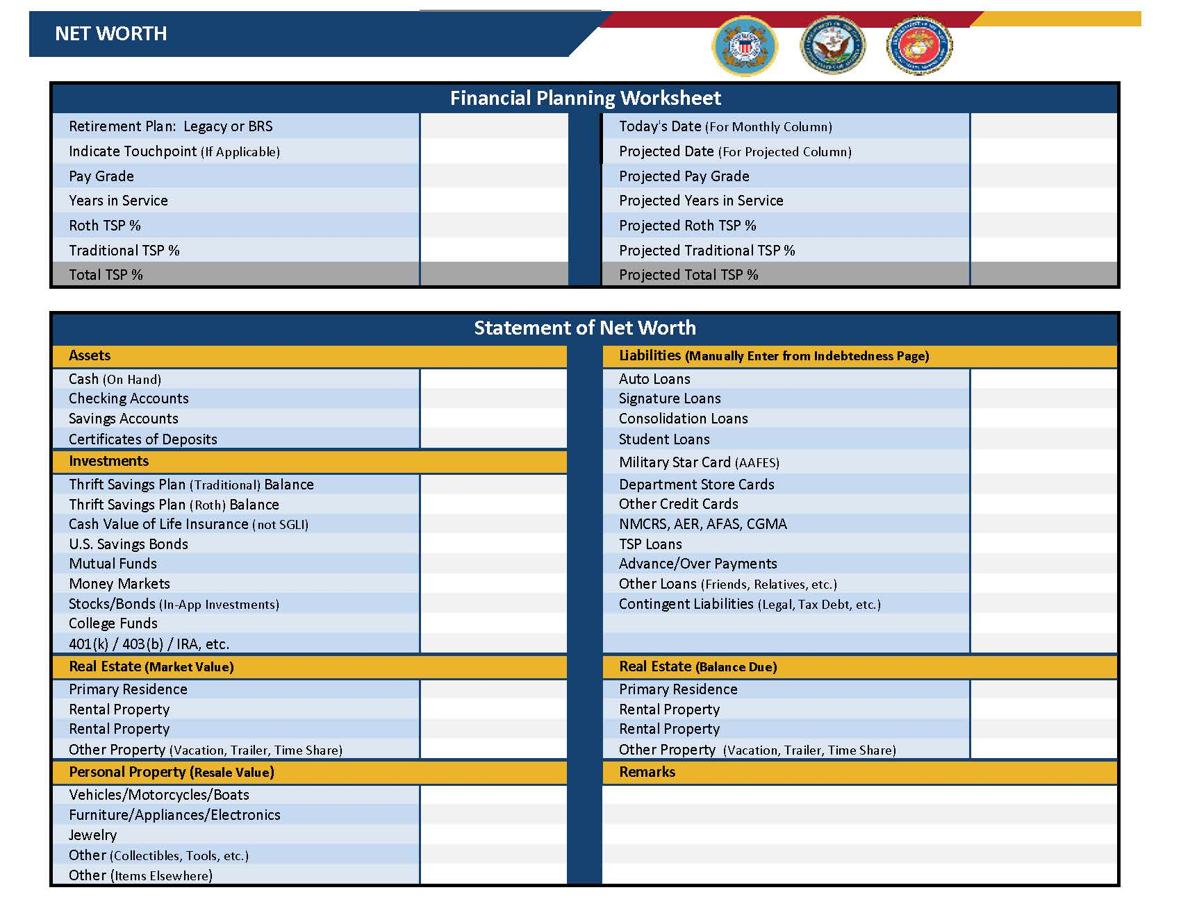
Net Worth Tab

Slide 4
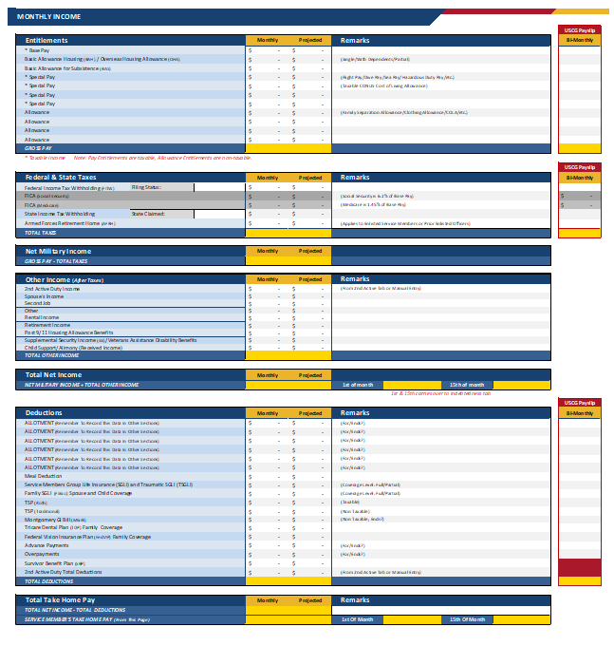
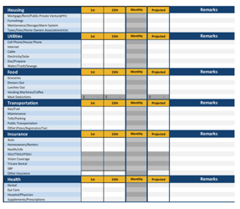
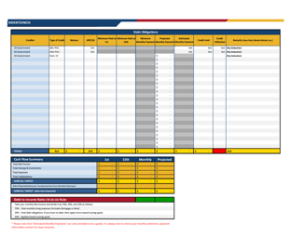
Spending Plan Tabs Overview
Income
Expenses
Indebtedness

Slide 5
Breakdown of Net Income
Recommended

Slide 6


Monthly Income
Gross Income
Total pay and allowances
Net Income
Gross Income less taxes
Take Home Pay
Net Income
less deductions or automatic allotments

Slide 7
Calculating Net Income
Example
Gross Income:
$4,200
All Monthly Taxes: $450
Net Income:
$4,200 - $450 =
$3,750
Minus Taxes:
Federal Taxes
State Taxes
Social Security
Medicare
Gross Pay
(Total Pay)
All military pay is taxed.
Allowances, with the exception of CONUS COLA, are not taxed.

Slide 8
Overview of the Savings and Living Expenses Tabs
Savings
Expenses
Emergency
Reserve
Goal Getter
TSP
IRA
Investment
Household and Utilities
Food
Clothing
Transportation
Insurance
Leisure

Slide 9
Savings Categories
Emergency Fund
  The unexpected
Reserve Fund
  Items paid for regularly, but not monthly
Goal Getter Fund
  Short-term financial goals
TSP
  Retirement
Investments/IRAs/etc.
  Medium-term and long-term financial goals

Slide 10
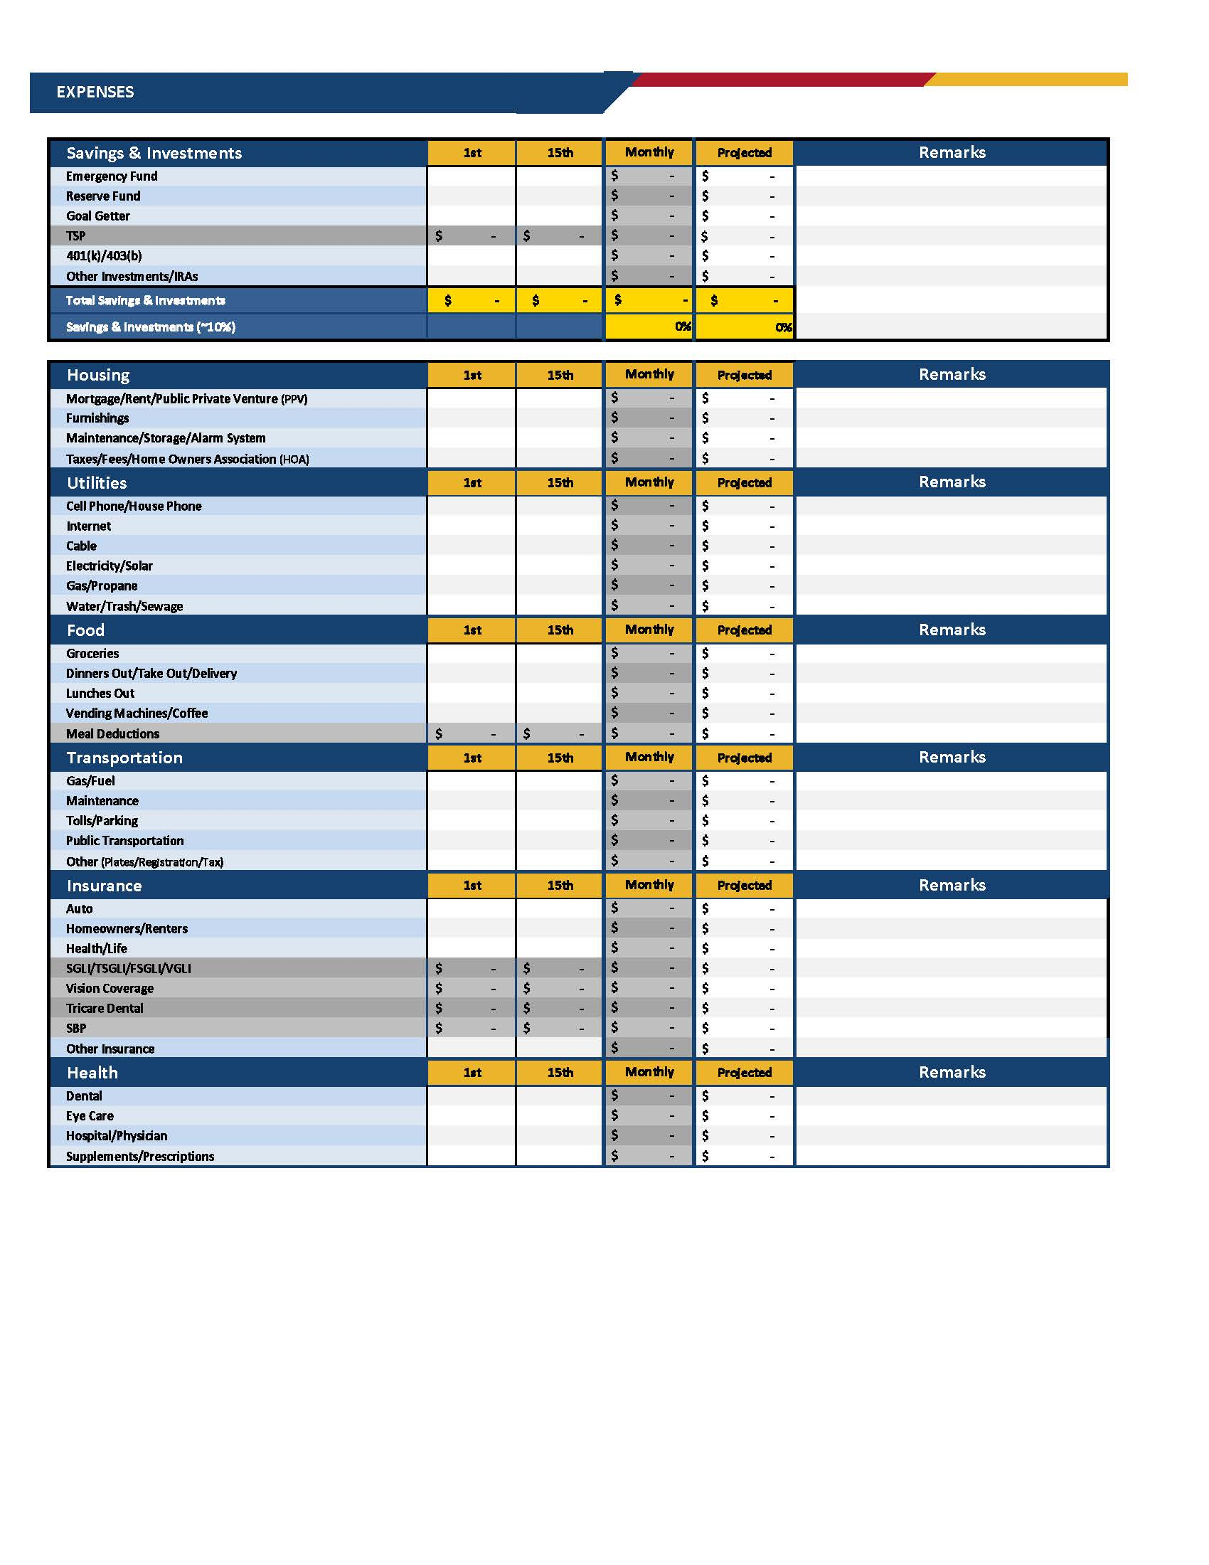
Living Expenses
Fixed vs. Variable
Use the Remarks column
“Back into” the figures needed
Less than 70% of net income

Slide 11
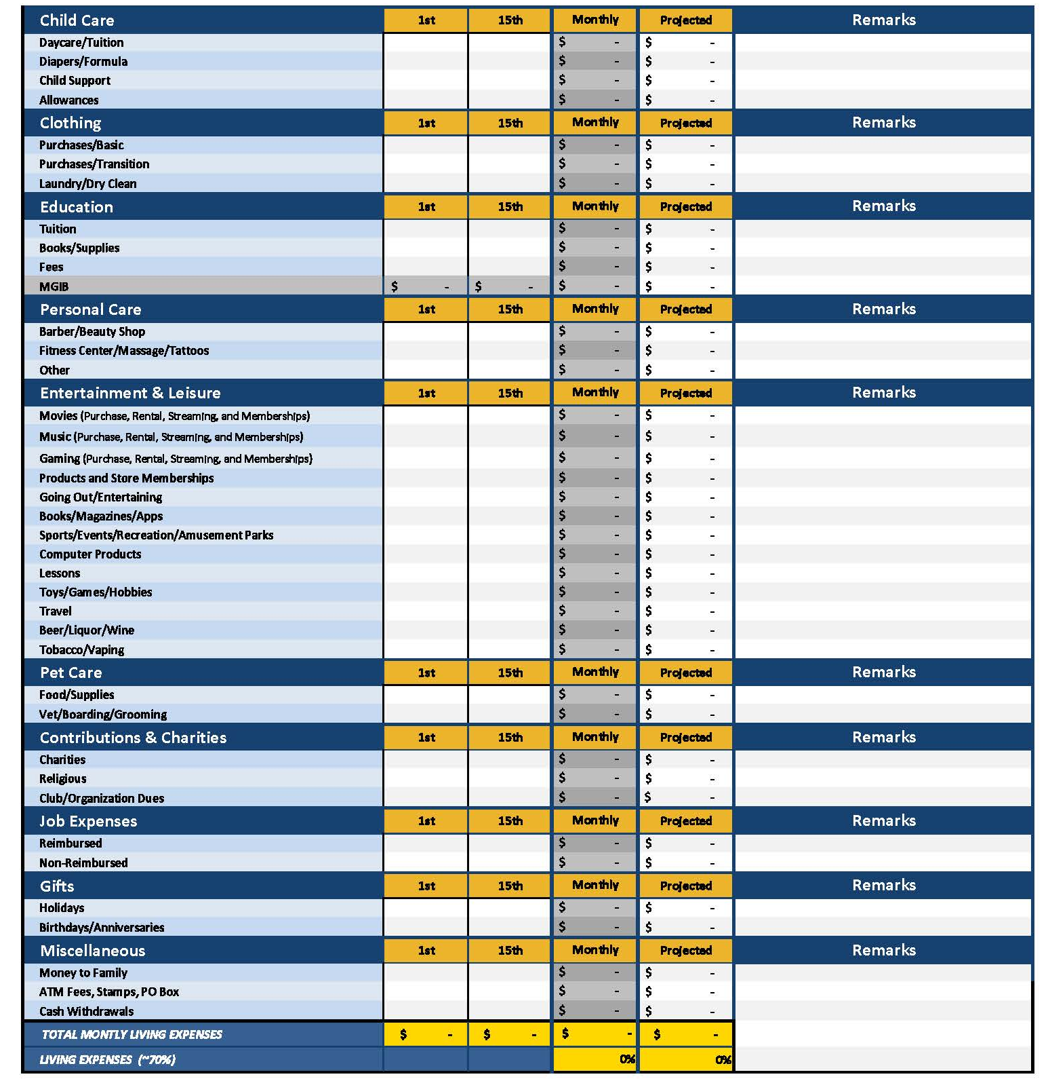
Tracking Expenses
Track spending for 4 weeks
Record all expenses daily
Group expenditures by category

Slide 12
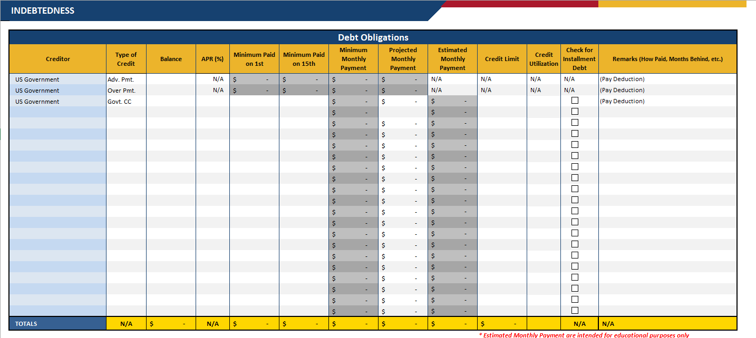
Indebtedness Tab
Creditor
Balance
APR
Minimum Monthly Payment
Credit Limit

Slide 13
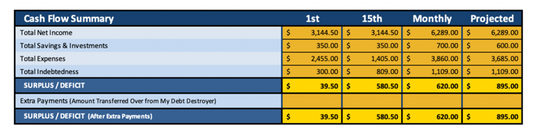
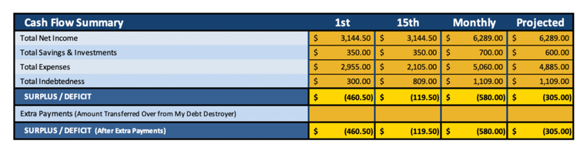
Cash Flow Summary
Surplus
Deficit

Slide 14
Debt-to-Income Ratio
Target: maximum of 20% of income
< 15%
15% – 20%
21% – 30%
> 30%
Proceed with caution
Adding more debt could put you over 20%
Fully extended
Seek financial coaching to keep debt within recommended limits
Overextended
Strongly encouraged to seek financial coaching
Seriously overextended
Seek help!
Contact your
local PFM
These values are not used to establish someone’s creditworthiness but to gauge overall financial health.

Slide 15
Financial Health Assessment Tab

Slide 16
Action Plan
Increase income and savings
Decrease living expenses
Decrease indebtedness
Recommended training and referrals
Financial goals
Using the projected columns

Slide 17

Debt Destroyer® Tab

Slide 18


Debt Snowball
List debts smallest to largest by balance
Pay minimum required on each
Put any extra money toward smallest balance
Celebrate paying off smallest balance
Use prior payment plus extra to pay next
Keep going until all are paid off

Slide 19

Debt Avalanche
List debts from highest to lowest interest rate
Pay the minimum payment on each
Put any extra money toward highest interest rate debt
Celebrate paying off highest interest rate debt
Use prior payment plus extra to pay next
Keep going until all are paid off!

Slide 20
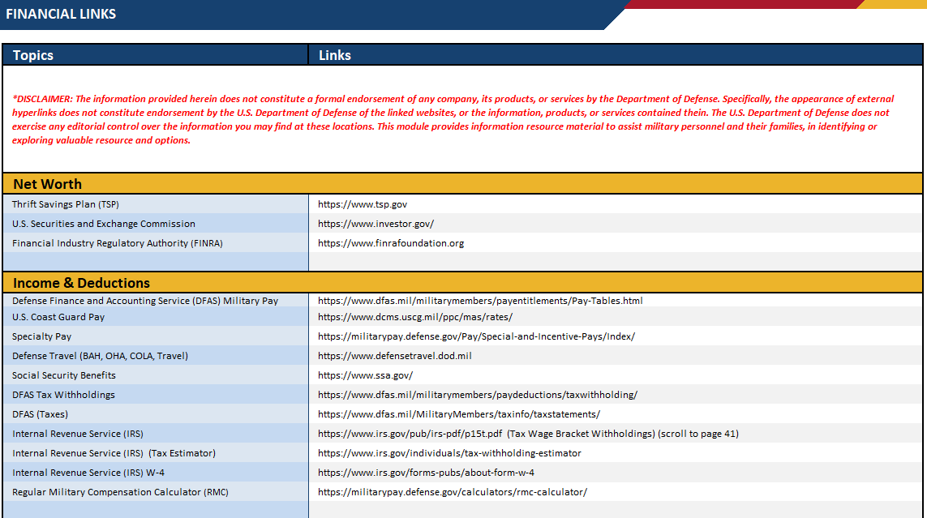
Financial Links Tab

Slide 21
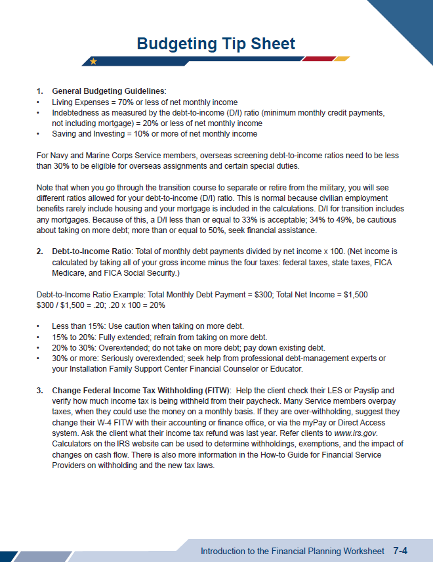
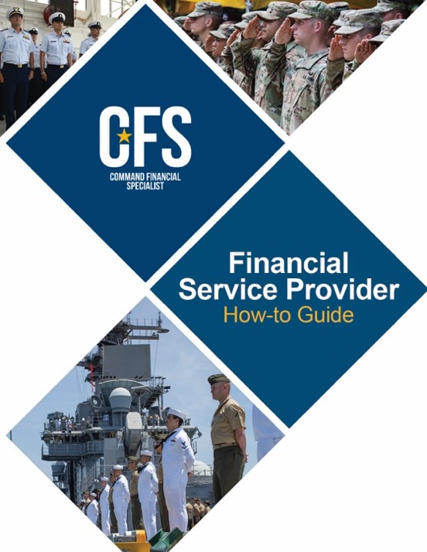
Chapter Resources
SM
3-3 to
3-7

